Slide 1
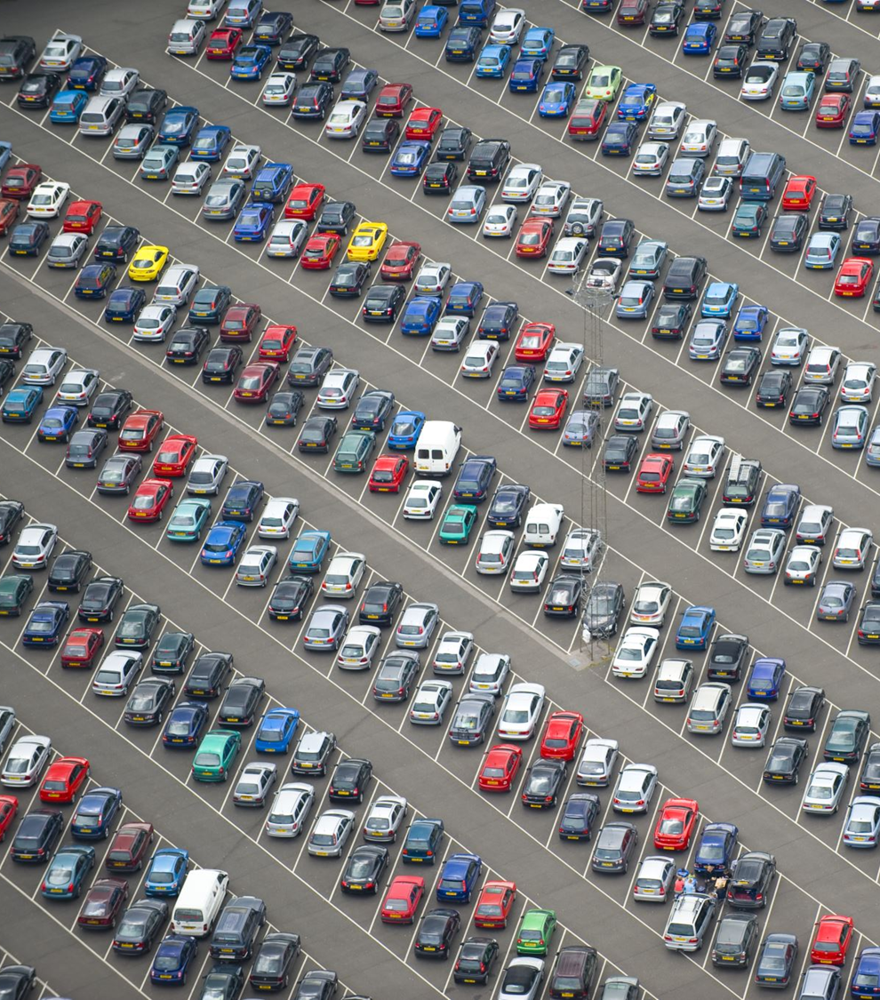


PREDICTING USED CAR PRICES USING MACHINE LEARNING
Presented By
Swetha J
Harini H

Slide 2
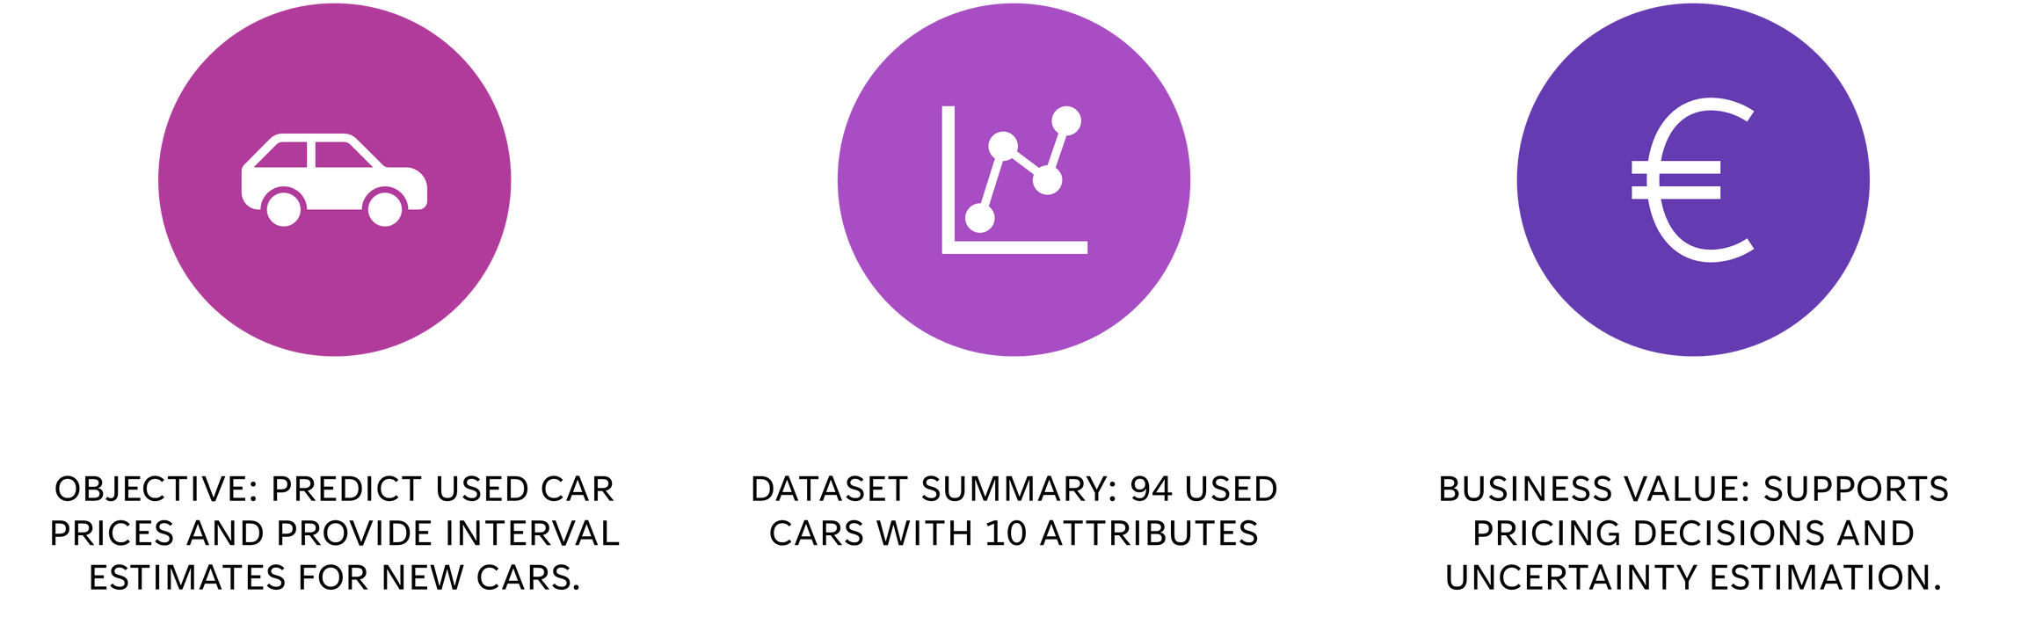
PROBLEM STATEMENT
Source: Kaggle (Used Car Price Prediction Dataset)
Objective:
Predict the resale price of used cars based on features like brand, year, mileage, fuel type, and engine size.
Dataset summary:
4,009 used cars with 12 attributes
Project Goal:
Helps buyers and sellers estimate fair prices and make informed purchasing decisions.

Slide 3


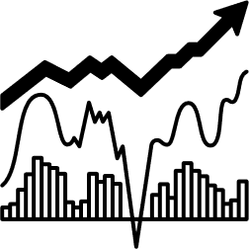

DATASET ANALYSIS
PRICE & MILEAGE INSIGHTS
Price is right-skewed with most cars under $20K. Mileage also skews low, mainly under 100K miles.
BRAND TRENDS & RELATIONSHIPS
Brands like Toyota, Ford, and BMW dominate the data. Strong links observed between price, mileage, age, and model.
MISSING VALUES, DUPLICATES & OUTLIERS
Missing values filled using median. Duplicates removed. Outliers handled using IQR to avoid distorted predictions.

Slide 4
Research Review
Dataset Collection
Data Cleaning
Data Preprocessing
METHODOLOGY
Exploratory Data Analysis
Feature Engineering
Training Set
Testing Set
Model Selection
Model Evaluation
Prediction

Slide 5
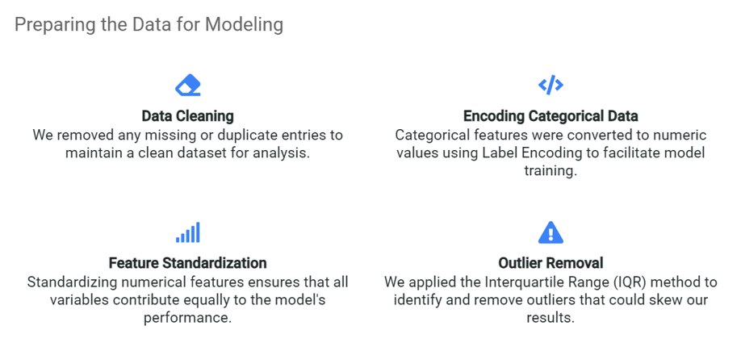
DATA PREPROCESSING

Slide 6
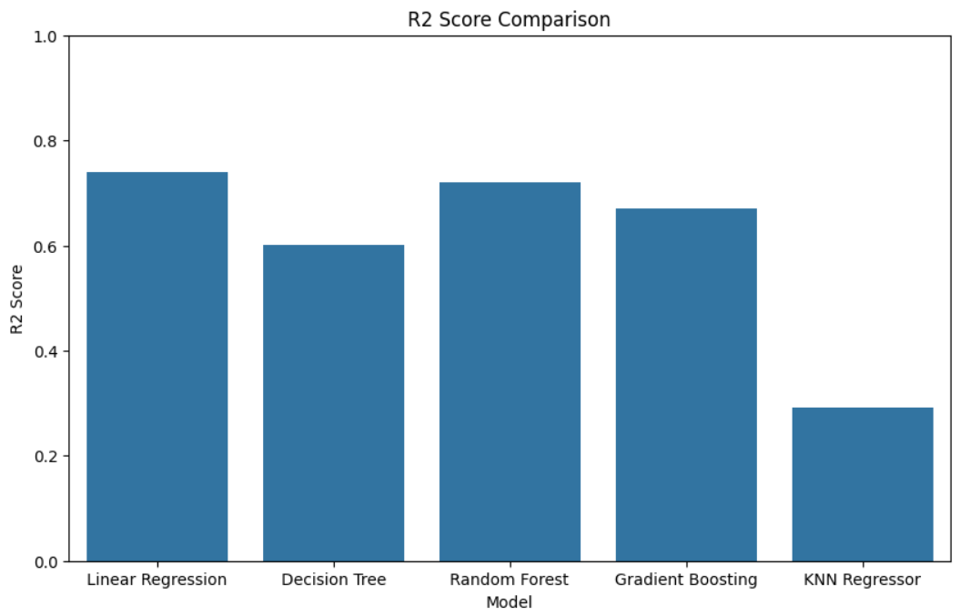
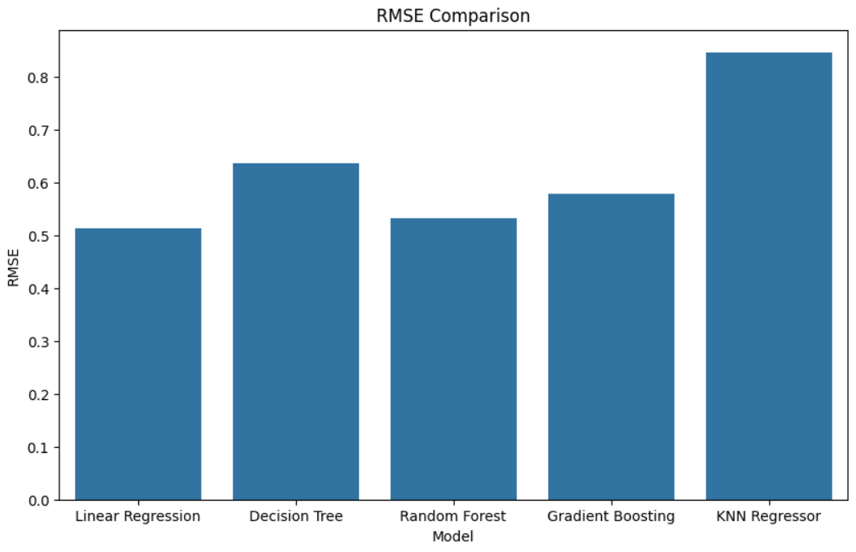
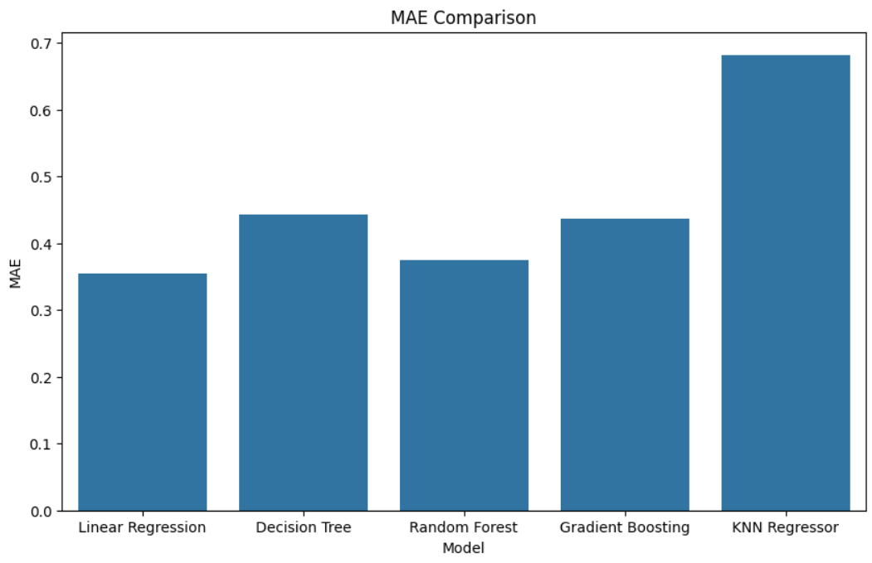
REGRESSION MODELS CONSIDERED
Linear Regression
Decision Tree Regressor
Random Forest Regressor
Gradient Boosting Regressor
KNN Regressor

Slide 7
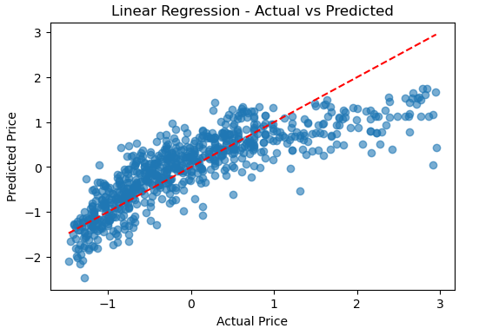
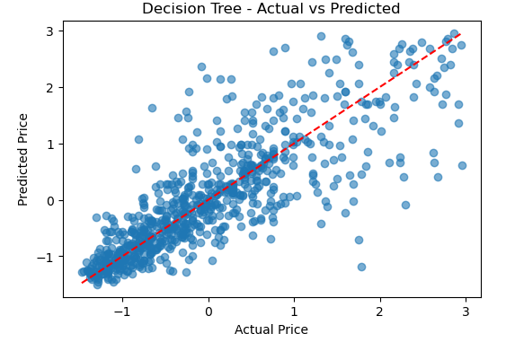
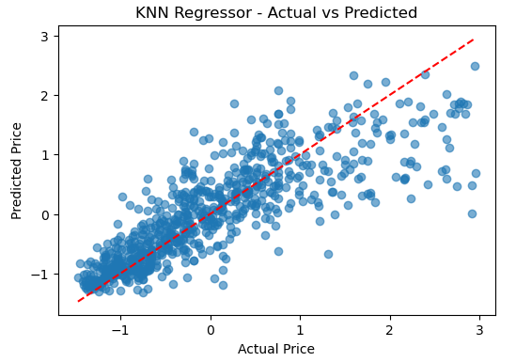
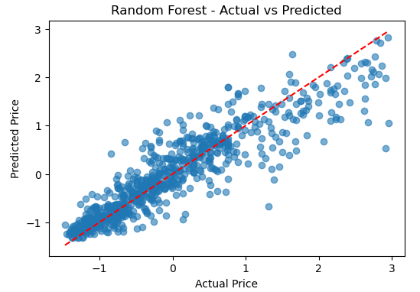
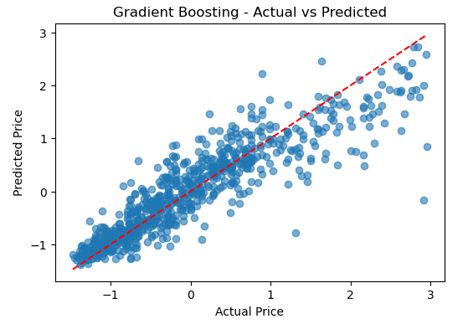

Slide 8
SELECTED MODEL
RANDOM FOREST REGRESSOR
Handles non-linear data
Robust to outliers
High accuracy
Better predictions on unseen data
Easy integration
MODEL PERFORMANCE
R² Score: 0.8276
MAE: 0.2903
RMSE: 0.4178

Slide 9



APPLICATION & NEXT STEPS
REAL-TIME DEPLOYMENT:
Model will be deployed using Streamlit to provide instant car price predictions through a simple, interactive interface.
SMART USER INPUTS:
Users can enter car details and instantly receive market price estimates, improving decision-making for buyers and sellers.
FUTURE ENHANCEMENTS:
We aim to add more features and try advanced ensemble models to boost accuracy, stability, and real-world performance.

Slide 10
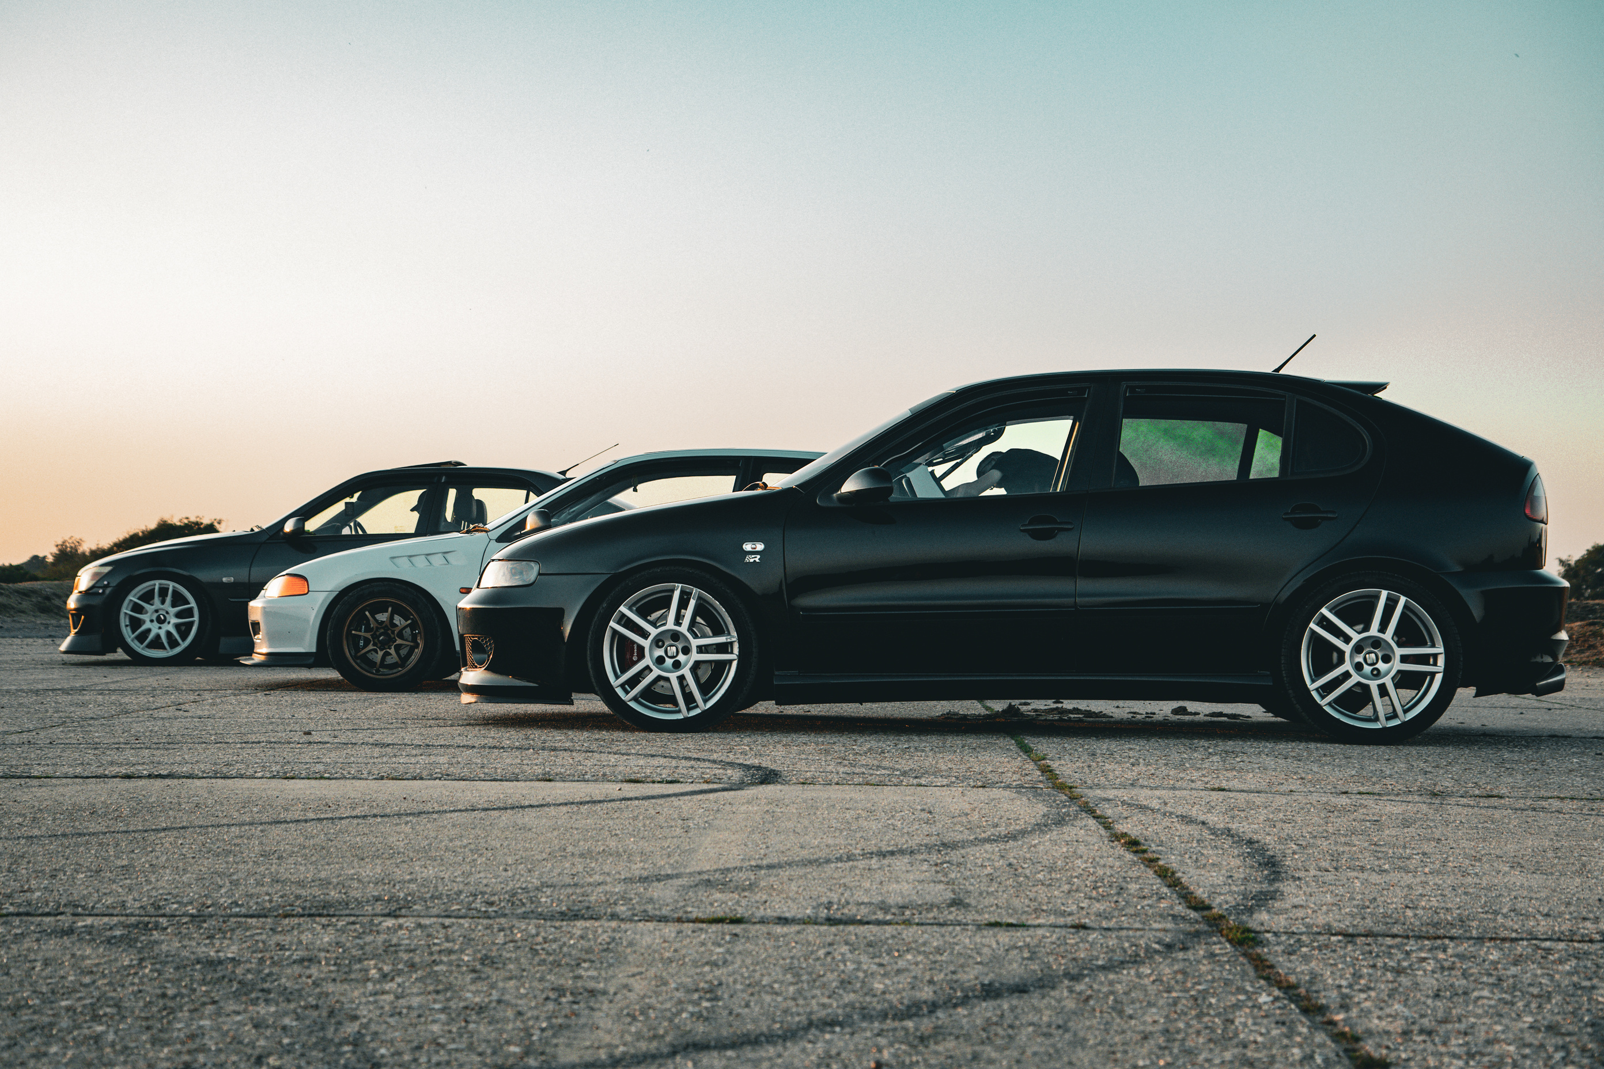
THANK YOU

